Slide 1

Unit Testing code

Slide 2
Module Objectives
Investigate Unit testing in Java and C#
Learn how to construct Unit testing code
How to manage Exceptions

Slide 3
What are the different types of test?
Earlier we saw there are many categories of tests
Unit Testing
Integration Testing
System Testing
Acceptance Testing
Tests should examine non-functional as well as the functional requirements
In this chapter we will investigate Unit testing which is essential for testing any IT system

Slide 4
Unit testing rules!
Test one thing at a time.
One method
One aspect of that method
Avoid multiple tests inside one unit test
Avoid if-statements (or complex logic)
If you feel the need for an if-statement, then create more test methods!
No dependency between methods in a unit test
It should not matter in which order the tests are run

Slide 5
Unit testing rules…
Avoid hard-coded values unless necessary.
Unit tests should be stateless:
Do not modify or depend on global data.
Clearly define pre-conditions.
Instantiate all required objects.
Tests must be deterministic:
The same input should always yield the same result.
Avoid dependencies on databases, files, or web services.

Slide 6
Unit testing rules…
Tests must run fast!
Essential for CI/CD.
Encourage frequent execution.
Avoid external dependencies in unit tests.
Unit tests ≠ integration tests.
Use mocking frameworks instead.
Keep test scripts simple.
Easy to read and modify.
Minimize added complexity - code already has enough bugs!
Test each branch of an IF statement separately.

Slide 7
Unit Tests must be…
Automatic
it checks its own results
Repeatable
it can be run again with the same results
Available
it accompanies the code being tested

Slide 8
Test Structure
Arrange
Set the starting conditions
Act
Invoke the method (or property) that is being tested
Assert
Decide if the test has passed or failed
@Test
void testCarAccelerate() {
Car car = new Car("Ford");
car.accelerate(10);
assertEquals(50, car.getSpeed());
}
Arrange
Act
Assert

Slide 9
What is xUnit?
“Family” of testing frameworks
JUnit for Java, NUnit and MSTest for .NET, Test::Unit for Perl
Simple framework with common design to organise and run tests
Setup, Test, Assertion, Tear Down
Essential for support of Extreme Programming and Test Driven Development (TDD)

Slide 10

JUnit test method for Java

Slide 11
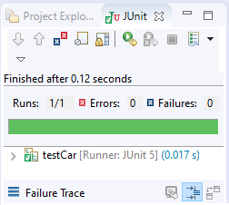
How to create a test?
Right click on the package name and select
New > Other > JUnit > JUnit test case
Select the CUT in the dialog and then write code:
Run the code
import static org.junit.jupiter.api.Assertions.*;
import org.junit.jupiter.api.Test;
class testCar {
@Test
void testCarAccelerate() {
Car car = new Car("Ford");
car.accelerate(10);
assertEquals(50, car.getSpeed());
}
}

Slide 12
JUnit @Before and @After annotations
class testCar {
Car car;
@BeforeEach
public void setUp() {
car = new Car("Ford");
}
@AfterEach
public void tearDown() {
car = null;
}
@Test
void testCarAccelerate() {
System.out.println("@test");
car.accelerate(10);
assertEquals(50, car.getSpeed());
}
}
Marks method to run before each @Test
Marks method to run after each @Test

Slide 13
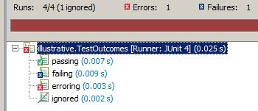
Statuses of a test
Passing: ultimately all our tests must pass
Failing: in TDD we always start with a test which fails
Erroring: test neither passes nor fails
Something has gone wrong, a run time error has occurred
Ignored: Using @Test @Ignore annotation

Slide 14
JUnit overloaded Assertions methods
assertEquals(Object expected, Object actual)
assertEquals(long expected, long actual)
assertEquals(String message, Object expected, Object actual)
assertEquals(String message, long expected, long actual)
assertEquals(double expected, double actual)
assertEquals(double expected, double actual, double delta)
Notes:
The methods most likely to be used all start assertEquals(…)
Remember the order of parameters – expected then actual. Tests that pass will still work if the parameters are the other way around. Tests that fail will still fail – however, the parameters are used in error reporting which could be confusing for other developers working on this code.
As well as overloaded assertEquals methods there are also assertArrayEquals methods.
Best practice would be to use the String version of an assert method so that the reason for failure will be stated if the assert fails.

Slide 15
JUnit Assertion methods 2
A
assertSame() – reference the same object
assertNotSame()
assertTrue() – check Boolean value
assertFalse()
assertNull() – check if an object is null
assertNotNull()
O
B
fail()
fail(String message)
Fail methods
Notes:
assertSame()/assertNotSame() will determine if two objects refer to the same object.

Slide 16
JUnit @Test annotation
@Test Marks a method as a JUnit test method
@Test(timeout = 200)
Will fail if the method takes longer than 200 milliseconds

Slide 17
Testing Expected Exceptions with JUnit
Approaches to testing for expected exceptions
@Rule
public ExpectedException exception = ExpectedException.none();
@Test
public void testConstrction() {
exception.expect(IllegalArgumentException.class);
exception.expectMessage(containsString("Invalid age"));
new Employee("Fred", -1);
}
1
To verify other properties of the exception,
2
@Test(expected = IllegalArgumentException.class)
public void testConstrction() {
new Employee("Fred", -1);
}
Junit 4 - Checks for only one exception
@Test
void testWithdrawWithInsufficientFunds() {
Account acc = new Account("B10", 100, "Bob");
assertThrows(InsufficientFundsException.class, () -> {
acc.withdraw(1000);
});
}
3
Junit 5
Notes:
The first approach using ExpectedException is the most flexible one because you can test the exception message. The class allows in-test specification of expected exception types and messages. The static none() method returns a rule that expects no exception to be thrown.
The second approach using @Test is the most straight-forward but it does not work for Junit 5. The third one is using a modern approach which does work for Junit 5.
Of course, you always have the option to use using a try-catch block which uses a familiar traditional approach, and it was used in older versions of Junit.

Slide 18

Unit testing method for .NET

Slide 19
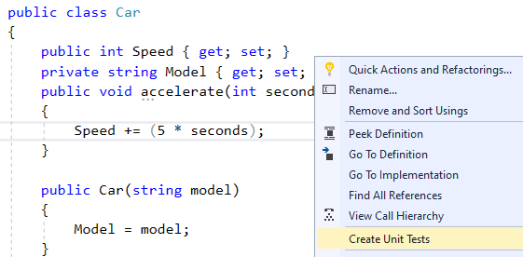
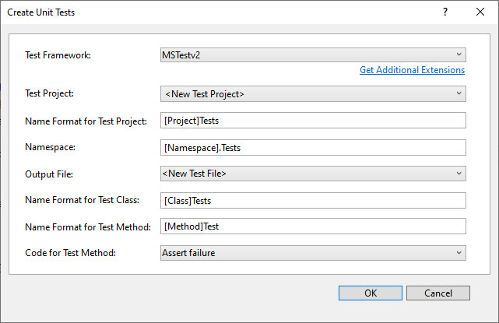
Create a MS-Test project

Slide 20
Write test code
[TestClass()]
public class CarTests {
Car car;
[TestInitialize]
public void SetUp() {
car = new Car("Ford");
}
[TestCleanup]
public void TearDown() {
car = null;
}
[TestMethod()]
public void accelerateTest() {
car.accelerate(10);
Assert.AreEqual(50, car.Speed);
}
}

Slide 21
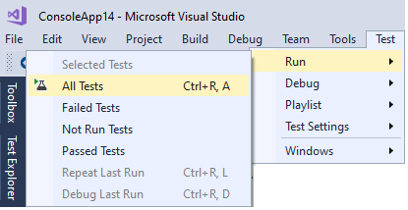
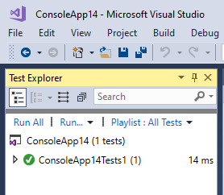
Run the tests

Slide 22
Testing Expected Exceptions with MS-Test
[TestMethod]
[ExpectedException(typeof(ArgumentException)]
public void TestNullUsername()
{
LogonInfo login = new Login(null, "password123");
}
[TestMethod]
[ExpectedException(typeof(ArgumentException), "username not specified")]
public void TestNullUsername()
{
LogonInfo login = new Login(null, "password123");
}

Slide 23
MS-Test specific
Attribute for data driven test where data can be specified inline
[DataTestMethod]
[DataRow(12, 3, 4)]
[DataRow(12, 2, 6)]
[DataRow(12, 4, 3)]
public void DivideTest(int n, int d, int q) {
Assert.AreEqual(q, n / d);
}

Slide 24
NUnit Example – C#
[TestFixture]
public class LoginTest {
[Test]
public void TestUserLoginforValidUser() {
// code… Assert.AreEqual(x, y); }
[Test]
public void NUnitTestExample() {
UserValidator sec = new UserValidator();
var ex = Assert.Throws<ArgumentException>(() => sec.login( null));
}
}

Slide 25
NUnit Example – C#
Attribute for data driven test where data can be specified inline
[Test]
[TestCase(12, 3, 4)]
[TestCase(12, 2, 6)]
[TestCase(12, 4, 3)]
public void DivideTest(int n, int d, int q) {
Assert.AreEqual(q, n / d);
}

Slide 26
Exercise
Please see your Exercise Guide
Develop and write unit tests in
Java
C#
Python and
JavaScript

